Slide 2
ABSTRACT:
The main challenges of age estimation from facial expression videos lie not only in the modeling of the static facial appearance, but also in the capturing of the temporal facial dynamics. This relies on sophisticated feature-refinement and framework-design. In this project, we present an end-to-end architecture for age estimation, called Spatially-Indexed Attention Model (SIAM), which is able to simultaneously learn both the appearance and dynamics of age from raw videos of facial expressions. Specifically, we employ convolutional neural networks to extract effective latent appearance representations and feed them into recurrent networks to model the temporal dynamics. More importantly, we propose to leverage attention models for salience detection in both the spatial domain for each single image and the temporal domain for the whole video as well.
We design a specific spatially-indexed attention mechanism among the convolutional layers to extract the salient facial regions in each individual image, and a temporal attention layer to assign attention weights to each frame. We demonstrate the strong performance of our model in experiments on a large, gender-balanced database with 400 subjects with ages spanning from 8 to 76 years. Experiments reveal that our model exhibits significant superiority over the state-of-the-art methods given sufficient training data

Slide 3
EXISTING SYSTEM:
In contrast, the spatially indexed mechanism achieves the best result among all options. Furthermore, adopting shared weights in the first layer and individual weights in the second layer (mediate spatially indexed mechanism) is much worse than the other order. It is probably because the individual weights can hardly take effect after the smoothing by the shared weights. Therefore, our model employs the spatially-indexed mechanism, which can not only clearly distinguish the face from the background, but also capture the salient regions like the area under the eye, area around mouth and two nasolabial folds in cheeks. More examples are presented. Quantitative comparison is also provided in, which demonstrates that the spatially-indexed mechanism outperforms other spatial attention mechanisms

Slide 4

DISADVANTAGES:
In contrast to regression and multi-class classification, some studies approach age estimation as an ordinal ranking problem. For instance, presents a deep (category-based) ranking model that combines deep scattering transform and ordinal ranking.
Formulates the problem as ordinal regression using a series of binary classification tasks which are jointly optimized by a multiple output CNN architecture.

Slide 5
PROPOSED SYSTEM:
Attention models have been proposed to let models learn by themselves to pay attention to specific regions in an image or different segments in a sequence according to the relevance to the aimed task. Likewise, different facial parts (in each single image) and different phases of the expression (in the inspected video) may exhibit varying degrees of salience to age estimation. To incorporate attention, we customize a specific attention module for spatial facial salience detection. To detect temporal salience in the sequential expression, we mount a temporal attention module upon the recurrent networks. It serves as a filtering layer to determine the amount of information of each frame to be incorporated into final age regression task. All functional modules of our proposed Spatially-Indexed Attention Model (SIAM) including convolutional networks for learning appearance, recurrent networks for learning dynamics, two attention modules as well as the final age regression module can be trained jointly, without any manual intervention.

Slide 6

ADVANTAGES:
Our model has the capacity to learn and it could do even better on more data while other models potentially saturate and do not get better no matter how much data you give them.
The potential advantages of using recurrent networks are that they learn relevant dynamics feature to the aimed task (age estimation) smoothly and progressively over time, all modules in our model can be trained jointly in an end-to-end manner to be compatible with each other.
We first investigate the different mechanisms to implement spatial attention and validate the advantages of our proposed spatially-indexed mechanism over other options.

Slide 7

HARDWARE REQUIREMENTS:
System : Intel core i3
Hard Disk : 1 TB
Monitor : 14’ Colour Monitor
Mouse : Optical mouse
RAM : 4GB

Slide 8



SOFTWARE REQUIREMENTS:
Operating System : Windows 10
Coding Language : Python
Front-End : Python IDE (version 3.7.4), PyCharm

Slide 9
NOVELTY:
We introduce a novel end to end architecture for age estimation from facial expression videos, which is able to automatically learn the static apperance in each single image and the temporal dynamics contained in the facial expression simultaneously. In particular we employ convolutional neural networks to model the static appearance due to its successful representation learning in the image domain. This project domain is mainly related to deep learning.Various algorithms and models are implemented and the main mechanism used is Spacial Indexed Attention model.

Slide 10
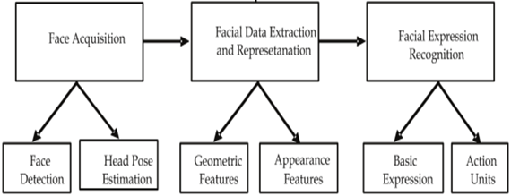
ARCHITECTURE
.

Slide 11
MODULES
Convolutional Neural Networks
Spatially Indexed Attention Module
Human Age Estimation

Slide 12
Convolutional Neural Networks
These kinds of methods rely on sophisticated feature design. In this work, we propose a novel end-to-end architecture for age estimation from facial expression videos, which is able to automatically learn the static appearance in each single image and the temporal dynamics contained in the facial expression simultaneously.
In particular, we employ convolutional neural networks (CNNs) to model the static appearance due to its successful representation learning in the image domain. In this way, both static appearance and temporal dynamics can be integrated seamlessly in an end-to end manner.
A key benefit of this design is that the learned static appearance features and temporal dynamic features are optimized jointly, which can lead to better performance for the final task of age estimation.

Slide 13
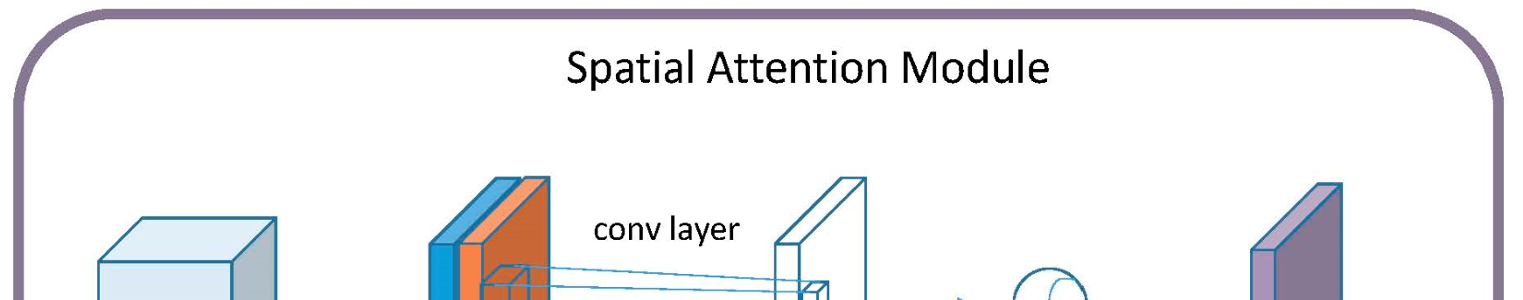
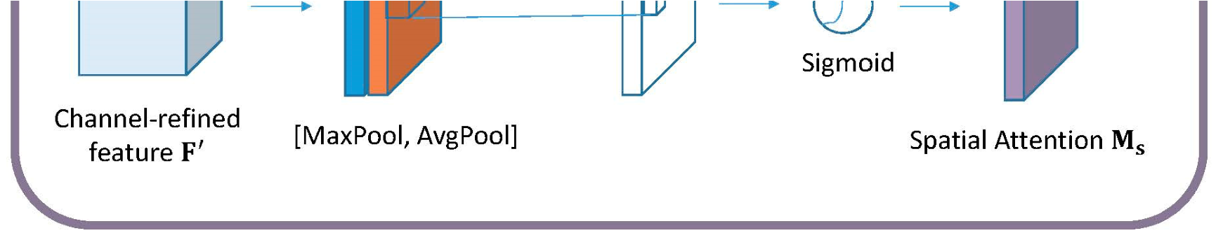
Spatially Indexed Attention Module
Attention models have been proposed to let models learn by themselves to pay attention to specific regions in an image or different segments in a sequence according to the relevance to the aimed task.
To detect temporal salience in the sequential expression, we mount a temporal attention module upon the recurrent networks. It serves as a filtering layer to determine the amount of information of each frame to be incorporated into final age regression task.
All functional modules of our proposed Spatially-Indexed Attention Model (SIAM) including convolutional networks for learning appearance, recurrent networks for learning dynamics, two attention modules as well as the final age regression module can be trained jointly, without any manual intervention.

Slide 14
Human Age Estimation
HUMAN age estimation from faces is an important research topic due to its extensive applications ranging from surveillance monitoring to forensic art and social networks.
The widely-used discriminative features for age estimation are appearance-related, such as wrinkles in the face, skin texture and luster; hence plenty of prevalent methods focus on modeling the appearance information from the static face.
It is reasonable since there are intuitive temporal dynamics involved in facial expressions which are relevant to the age. For instance, the exhibited facial movement like wrinkles in the smiling process is different for people of different ages.

Slide 15
UML DIAGRAMS:
Use case Diagram
Class Diagram
Sequence Diagram

Slide 16
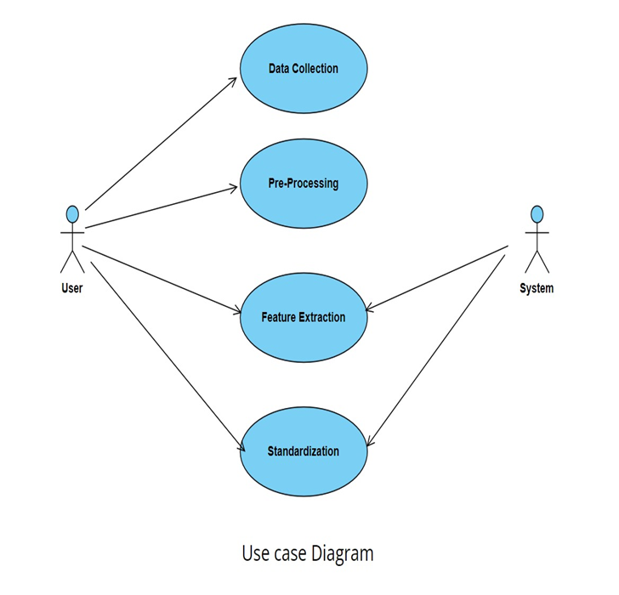
Use Case Diagram

Slide 17
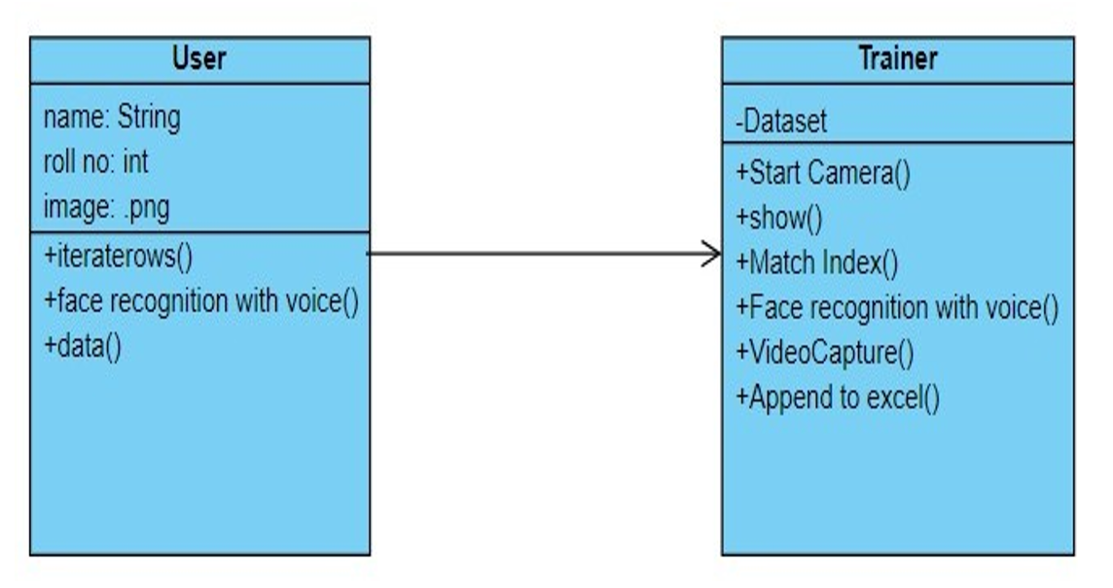
Class Diagram

Slide 18
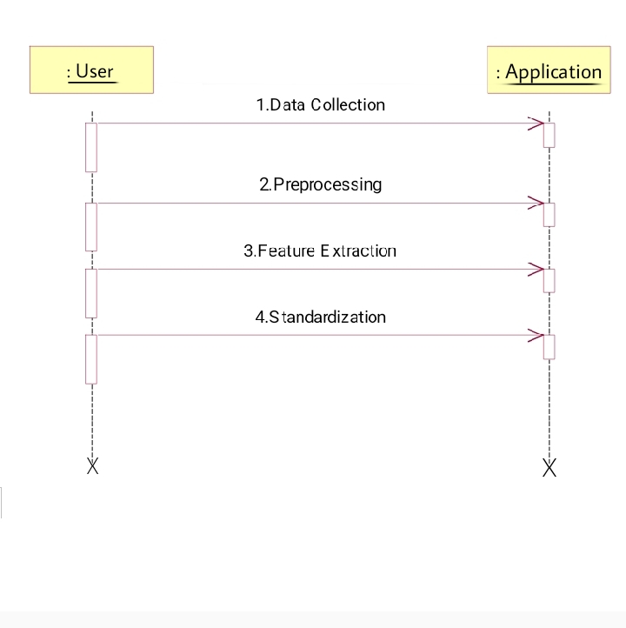
Sequence Diagram

Slide 19
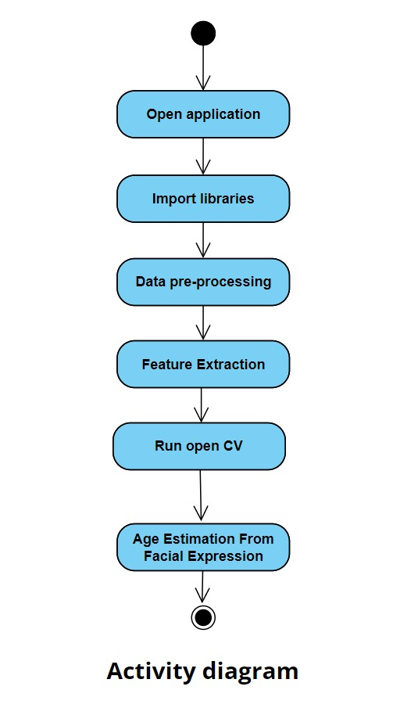
Activity Diagram

Slide 20
SAMPLE CODE
import sys
import argparse
import cv2
from libfaceid.detector import FaceDetectorModels, FaceDetector
from libfaceid.encoder import FaceEncoderModels, FaceEncoder
from libfaceid.pose import FacePoseEstimatorModels, FacePoseEstimator
from libfaceid.age import FaceAgeEstimatorModels, FaceAgeEstimator
from libfaceid.gender import FaceGenderEstimatorModels, FaceGenderEstimator
from libfaceid.emotion import FaceEmotionEstimatorModels, FaceEmotionEstimator
# Use flask for web app
from flask import Flask, render_template, Response
app = Flask(__name__)
# Set the input directories
INPUT_DIR_DATASET = "datasets"
INPUT_DIR_MODEL_DETECTION = "models/detection/“

Slide 21
INPUT_DIR_MODEL_ENCODING = "models/encoding/"
INPUT_DIR_MODEL_TRAINING = "models/training/"
INPUT_DIR_MODEL_ESTIMATION = "models/estimation/"
# Set width and height
RESOLUTION_QVGA = (320, 240)
RESOLUTION_VGA = (640, 480)
RESOLUTION_HD = (1280, 720)
RESOLUTION_FULLHD = (1920, 1080)
def cam_init(cam_index, width, height):
cap = cv2.VideoCapture(cam_index)
if sys.version_info < (3, 0):
cap.set(cv2.cv.CV_CAP_PROP_FPS, 60)
cap.set(cv2.cv.CV_CAP_PROP_FRAME_WIDTH, width)
cap.set(cv2.cv.CV_CAP_PROP_FRAME_HEIGHT, height)
else:
cap.set(cv2.CAP_PROP_FPS, 60)
cap.set(cv2.CAP_PROP_FRAME_WIDTH, width)
cap.set(cv2.CAP_PROP_FRAME_HEIGHT, height)
return cap

Slide 22
def label_face(frame, face_rect, face_id, confidence):
(x, y, w, h) = face_rect
cv2.rectangle(frame, (x, y), (x+w, y+h), (255, 255, 255), 1)
if face_id is not None:
cv2.putText(frame, "{} {:.2f}%".format(face_id, confidence),
(x+5,y+h-5), cv2.FONT_HERSHEY_SIMPLEX, 0.5, (255, 255, 255), 1, cv2.LINE_AA)
def process_facedetection():
cam_index = 0
cam_resolution = RESOLUTION_QVGA
model_detector=FaceDetectorModels.HAARCASCADE
model_poseestimator=FacePoseEstimatorModels.DEFAULT
model_ageestimator=FaceAgeEstimatorModels.DEFAULT
model_genderestimator=FaceGenderEstimatorModels.DEFAULT
model_emotionestimator=FaceEmotionEstimatorModels.DEFAULT
# Initialize the camera
camera = cam_init(cam_index, cam_resolution[0], cam_resolution[1])
try:
# Initialize face detection
face_detector = FaceDetector(model=model_detector, path=INPUT_DIR_MODEL_DETECTION)#, optimize=True)

Slide 23
# Release the camera
camera.release()
cv2.destroyAllWindows()
# Initialize for web app
@app.route('/')
def index():
return render_template('index.html')
# Entry point for web app
@app.route('/video_viewer')
def video_viewer():
return Response(process_facedetection(), mimetype='multipart/x-mixed-replace; boundary=frame')
if __name__ == '__main__':
# Run flask for web app
app.run(threaded=True, debug=True)

Slide 24
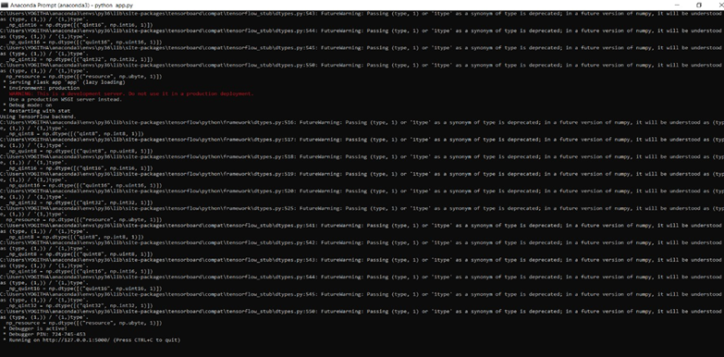
RESULTS

Slide 25
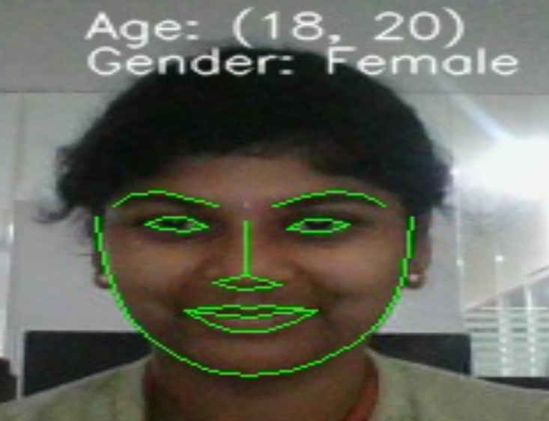
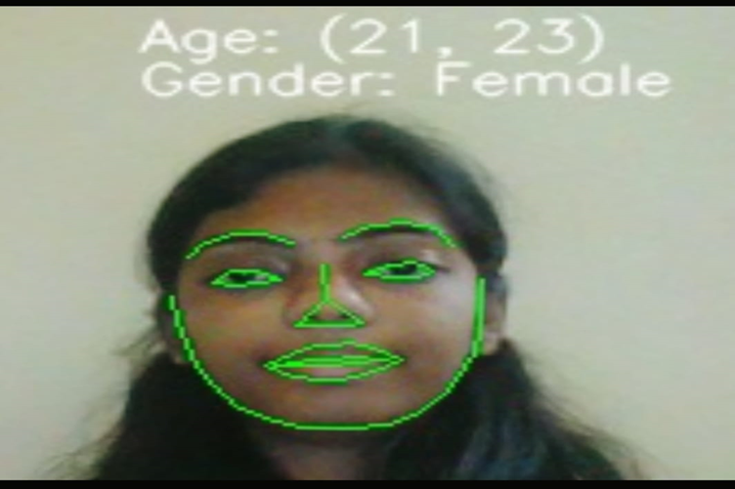
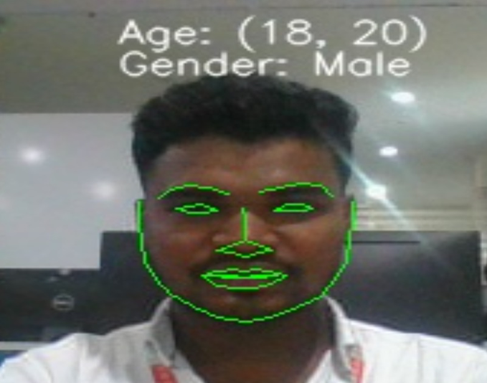
SCREENSHOTS

Slide 26
CONCLUSION:
In this project, we present an attended end-to-end model for age estimation from facial expression videos. The model employs convolutional networks to learn the effective appearance features and feed them into recurrent networks to learn the temporal dynamics. Furthermore, both a spatial attention mechanism and a temporal attention mechanism are added to the model. The spatial attention can be integrated seamlessly into the convolutional layers to capture the salient facial regions in each single image, while the temporal attention is incorporated in recurrent networks to capture the salient temporal frames. The whole model can be trained readily in an end-to-end manner. Provided that a sufficient number of samples are available for training, we show the strong performance of our model on a large smile database. Specifically, our model makes a substantial improvement over the state-of- the-art methods. In future work, we aim to leverage the pre-trained convolutional neural networks on large image data for the appearance learning instead of training our convolutional appearance module from scratch. This would not only accelerate the training speed but also allows employing quite deeper architectures and abundant existing image data to improve the performance of the appearance learning.

Slide 27
FUTURE ENHANCEMENT
The potential idea behind the idea of the project is the additional feature, we aim to leverage the pre-trained convolutional neural networks on large image data for the appearance learning instead of training our convolutional appearance module from scratch. This would not only accelerate the training speed but also allows employing quite deeper architectures and abundant existing image data to improve the performance of the appearance learning.

Slide 28
REFERENCES
G. Guo, Y. Fu, C. R. Dyer and T. S. Huang, "Image-based human age estimation by manifold learning and locally adjusted robust regression", IEEE Trans. Image Process., vol. 17, no. 7, pp. 1178-1188, Jul. 2008.
A. Lanitis, C. Draganova and C. Christodoulou, "Comparing different classifiers for automatic age estimation", IEEE Trans. Syst. Man Cybern. B Cybern., vol. 34, no. 1, pp. 621-628, Feb. 2004.
A. M. Albert, K. Ricanek and E. Patterson, "A review of the literature on the aging adult skull and face: Implications for forensic science research and applications", Forensic Sci. Int., vol. 172, no. 1, pp. 1-9, 2007.

Slide 29
GITHUB LINK
https://github.com/Stephennani/Age-estimation-using-facial-expressions

Slide 30


